Slide 1
Number Systems
Mack 2021

Slide 2
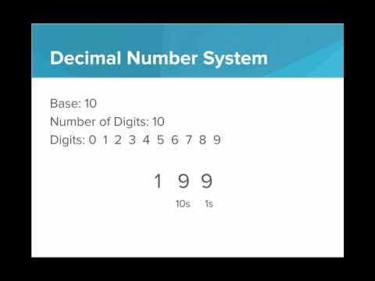
In this video we introduce number systems, and show how the binary and decimal number systems work the same way, but with a different number base

Slide 3
Number Base Tool
Explore this tool to gain familiarity with converting from the binary number system to the decimal number system, then answer the following discussion questions:
How many possible values can be created with 8 bits?
What is the highest value that can be created with only 6 bits?
How can you quickly tell if a binary number is odd or even?
If a binary value has only a single 1, what must be true about the value?
What is the relationship between 1002 and 10002? What about 10002 and 100002? What mathematical operation is performed to add a 0 to the end of a binary number? Is this similar to the mathematical operation performed to add a 0 to the end of a decimal number?

Slide 4
What is the number base of the binary number system?
Notes:
🍐 This is a Pear Deck Multiple Choice Slide. Your current options are: A: 10, B: 2, C: 1, D: 0,
🍐 To edit the type of question or choices, go back to the "Ask Students a Question" in the Pear Deck sidebar.

Slide 5
In the binary value 1002, what is the place value of the 1?
Notes:
🍐 This is a Pear Deck Multiple Choice Slide. Your current options are: A: 100s place, B: 2s place, C: 4s place, D: 1s place,
🍐 To edit the type of question or choices, go back to the "Ask Students a Question" in the Pear Deck sidebar.
C

Slide 6
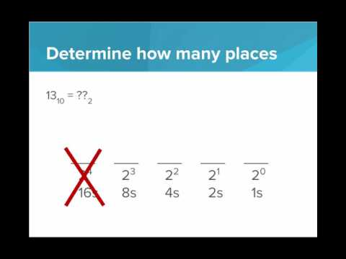
In this video we learn how to convert a number from decimal to binary.

Slide 7
What is the value of 1310 in binary?
Notes:
🍐 This is a Pear Deck Multiple Choice Slide. Your current options are: A: 101, B: 1101, C: 1110, D: 10000,
🍐 To edit the type of question or choices, go back to the "Ask Students a Question" in the Pear Deck sidebar.

Slide 8
Binary Game
This exercise is a visual game to practice making numbers in binary. Clicking on each bit toggles the value from a 0 to a 1, or vice versa.
The decimal target value is shown in the bottom of the window. Flip the bits of the binary number until you successfully create the binary value that represents the given decimal value.
Try to get at least 1000 points before moving on!

